Slide 1


Intersection of Code Pairs
Nurgül Kangal
Engincan Varan
Cem Güneri
17.07.2019

Slide 2

Overview
Introduction
Theoretical Framework
Background & Literature Reviews
Future Plans

Slide 3
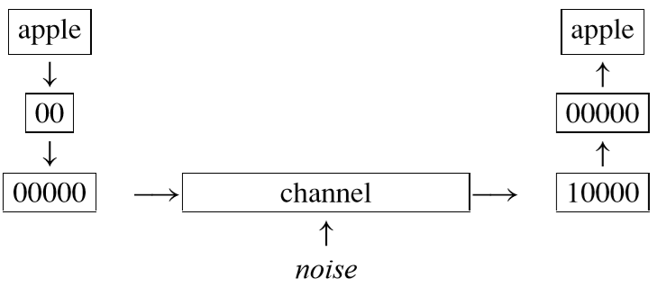
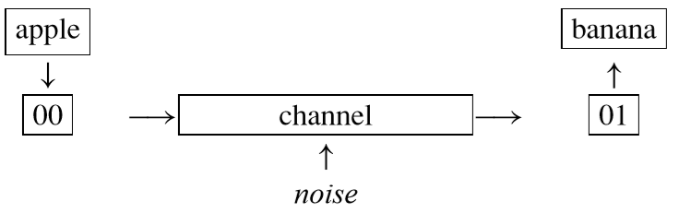
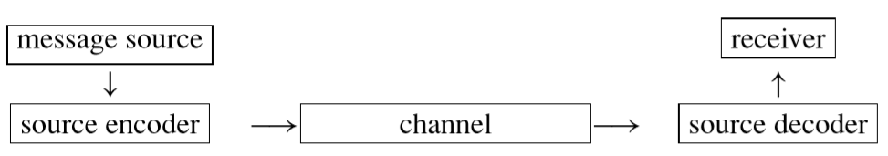
Introduction

Slide 4
Theoretical Framework
Finite Fields
Vector Spaces
Linear Codes
Parameters of Linear Codes (n,k,d)
Inner Product
Dual Code of C
Linear Complementary Dual (LCD) Codes

Slide 5
Fields
A ﬁeld is a nonempty set F of elements with two operations ‘+’ (called addition) and ‘·’ (called multiplication) satisfying the following axioms;
For all a,b,c ∈ F:
F is closed under “+” and “·” → a+b and a·b are in F
Commutative laws → a+b = b+a , a·b = b·a
Associative laws → (a+b)+c =a+(b+c) , a·(b·c)=(a·b)·c.
Distributive law → a·(b+c)=a·b+a·c.
Identity element for addition → a+0=a for all a ∈ F.
Identity element for multiplication → a·1=a and a·0=0 for all a ∈ F.
For any a in F, there exists an additive inverse element (−a) in F such that a+(−a)=0.
For any a = 0 in F, there exists a multiplicative inverse element a⁻¹ in F such that a·a⁻¹ =1.

Slide 6
Fields
Infinite Fields: If a field have infinitely many elements, it is called an “Infinite Field”. For example:
ℝ (Reel Numbers) , 𝘘 (Rational Numbers)
𝒵 (Integers)

Slide 7
Fields
A ﬁeld is a nonempty set F of elements with two operations ‘+’ (called addition) and ‘·’ (called multiplication) satisfying the following axioms;
For all a,b,c ∈ F:
F is closed under “+” and “·” → a+b and a·b are in F
Commutative laws → a+b = b+a , a·b = b·a
Associative laws → (a+b)+c =a+(b+c) , a·(b·c)=(a·b)·c.
Distributive law → a·(b+c)=a·b+a·c.
Identity element for addition → a+0=a for all a ∈ F.
Identity element for multiplication → a·1=a and a·0=0 for all a ∈ F.
For any a in F, there exists an additive inverse element (−a) in F such that a+(−a)=0.
For any a = 0 in F, there exists a multiplicative inverse element a⁻¹ in F such that a·a⁻¹ =1.

Slide 8
Fields
Infinite Fields: If a field have infinitely many elements, it is called an “Infinite Field”. For example:
ℝ (Reel Numbers) , 𝘘 (Rational Numbers)
𝒵 (Integers)
Finite Fields: If a field have finitely many elements, it is called a “Finite Field”. For example:
𝒵₃ = { 0 , 1 , 2} → F₃
+ | 0 | 1 | 2
0 | 0 | 1 | 2
1 | 1 | 2 | 0
2 | 2 | 0 | 1
. | 0 | 1 | 2
0 | 0 | 0 | 0
1 | 0 | 1 | 2
2 | 0 | 2 | 1

Slide 9
Fields
There is an important theorem about Finite Fields:
A Finite Field of order q exists if and only if the order q is a prime power p^{k}, where p is a prime number and k is a positive integer.
For example:
F₂ → 2 elements
F₃² → 9 elements

Slide 10
Vector Spaces
Let F_{q} be the ﬁnite ﬁeld of order q. A nonempty set V, together with some vector addition and scalar multiplication by elements of F_{q}, is a vector space over F_{q} if it satisﬁes all of the following conditions;
For all u,v,w∈ V and for all λ,µ ∈ F_{q}:
u+v ∈ V
(u+v)+w = u+(v+w)
There is an element 0 ∈ V with the property 0+v = v = v+0 for all v ∈ V
For each u ∈ V there is an element of V, called “−u”, such that u+(−u)= 0 =(−u)+u
u+v=v+u
λv∈ V
λ(u+v)= λu+λν ,(λ+µ)u= λu+µu
(λµ)u= λ(µu)
If 1 is the multiplicative identity of F_{q}, then 1u=u.

Slide 11
Vector Spaces
Examples:
R², R³, … R^{n} → Vector Spaces over R
F₅² → Vector Space over F₅
F₁₇⁸ → Vector Space over F₁₇

Slide 12
Linear Codes
A linear code of length n over the ﬁnite ﬁeld F_{q} is simply a subspace of the vector space F_{q}^{n}.
C = { x = (x₁,x₂,… ,x_{n} ) | x_{i} ∊ F_{q} ,1 ≤ i ≤ n }

Slide 13
Parameters of Linear Codes ( n , k , d )
Let C [n,k,d] be a linear code over F_{q}.
n → length of the linear codes
k → dimension of the linear codes
d → minimum distance of the linear codes

Slide 14
Inner Product over F_{q}^{n}
Let u = ( u₁ , u₂ … , u_{n} ) and v = ( v₁ , v₂ … , v_{n} ) are any element of F_{q}^{n}.
Then, the inner product of 2 elements is defined as;
u.v = < u,v > = u₁v₁ + u₂v₂ + … u_{n}v_{n} ∊ F_{q}

Slide 15
Dual Code of C
The dual code of C is C⊥, the orthogonal complement of the subspace C of F_{q}^{n}.
C⊥ = { y ∊ F_{q}^{n} | < x,y > = 0, for all x ∊ C }

Slide 16
LCD Codes
A linear code with complementary dual (An LCD code) is a linear code C satisfying C ∩ C⊥ = {0}.

Slide 17
An Example for LCD Codes
Example 1
Imagine we are working over F₂³:
Let C = { 000 , 111 }
Then C⊥ = { 000 , 011 , 101 , 110 }
So, C ∩ C⊥ = { 000 }
Example 2
Imagine we are working over F₂²:
Let C = { 00 , 11 }
Then C⊥ = { 00 , 11 }
So, C ∩ C⊥ = { 00 , 11 }
C = C⊥
Notes:
jbdbdbccbnnbc

Slide 18
Background/Literature Review
Coding Theory
Sang Ling - Chaoping Xing
Some bounds on binary LCD codes
Lucky Galvez·Jon-Lark Kim·Nari Lee· Young Gun Roe·Byung-Sun Won
Cryptogr. Commun. (2018) 10:719–728, https://doi.org/10.1007/s12095-017-0258-1

Slide 19
Future Plans
More Articles, Journals …
Applications of these LCD Codes
Researches about the parameters [ n , k , d ]

Slide 20
Thank You For Listening!

